Slide 1



Sentiment Analysis on Food reviews
Capstone Project
Felicia Chua
Notes:
Sentiment analysis aka opinion mining is a natural language processing technique used to determine whether the data is positive, negative or neutral.

Slide 2
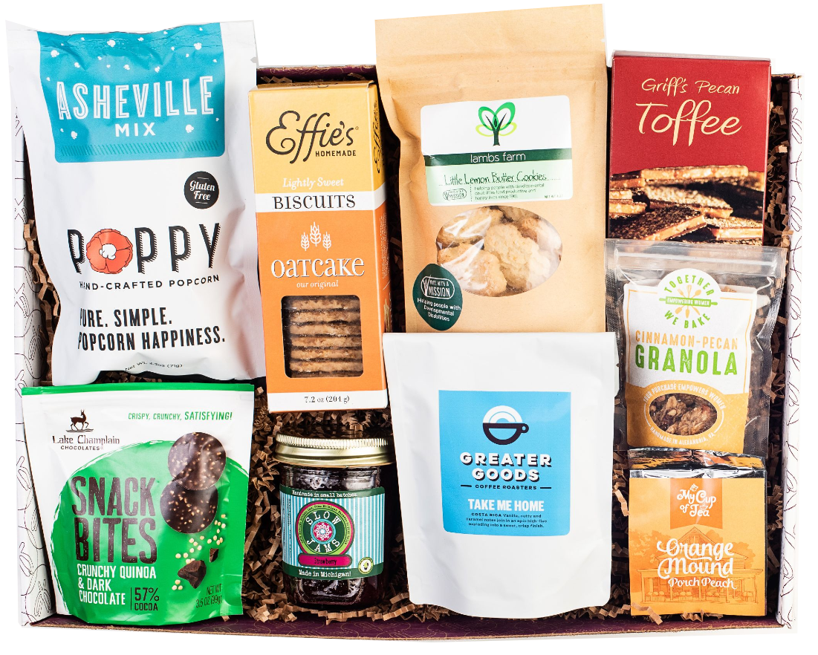
Problem Statement
Reviews affect customers’ purchasing decision.
They judge the quality of an item based on previous customers’ feedback.
As part of the data scientist team in Consultancy of food product, we aim to classify the sentiment of reviews and to see if there are any potential roadblocks to customers' satisfaction.
Notes:
Many e-commerce prompt users to leave a review after purchasing an item from their website to understand a customer's experience. Reviews can affect another customers' decision on whether to purchase or not. Customers would judge the quality of an item based on previous customers' feedback. As part of the data scientist team in Consultancy of food product, we aim to classify the sentiment of reviews and to see if there are any potential roadblocks to customers' satisfaction.

Slide 3


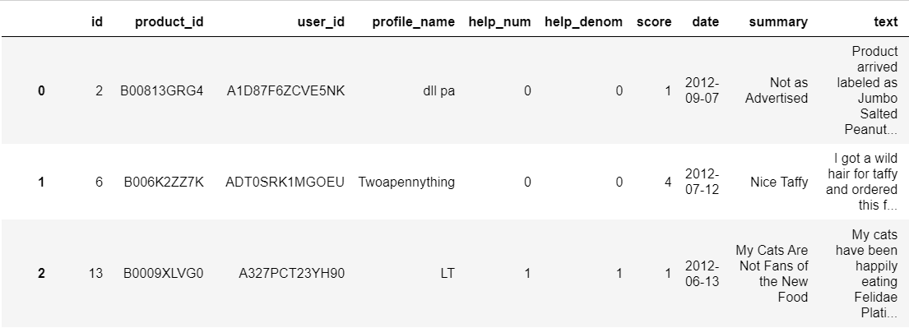
Background of dataset
Notes:
Amazon.com Inc. is an American multinational technology company. It started out as an online bookseller and expanded its offerings to include music, clothings and a vast assortment of merchandise. It grown into an e-commerce behemoth. Currently, it is one of the prime site that shoppers would browse to buy anything from food to electronics.
Helpfulness: number of users who found review helpful and total number of users who indicated if they found the review helpful or not
With an increase in online shopping, giving reviews and ratings are how customers give feedback for businesses to understand the wants and needs of users. Given that Amazon sells a wide range of food products, we would tap on its review dataset to categorize the sentiments.

Slide 4
01
Data Cleaning

Slide 5

Let’s Clean
Keep latest year
Remove duplication
Cluster ratings
Removing years before 2012
Similar product had same reviews
(same brand but different product)
Ratings 1 - 3: Negative sentiment
Ratings 4 - 5: Positive sentiment

Slide 6




Pre-processing
English
words
Lower-case
Characters
Stemming
Remove ‘&#1056;&#1077;&#1096;&#1080;&#1083;&#1072; &#1079;.....’
Conversion to lower-cases
Remove html tags and non letters
Convert word to its root form & remove suffixes / prefixes

Slide 7
02
Exploratory Data Analysis

Slide 8
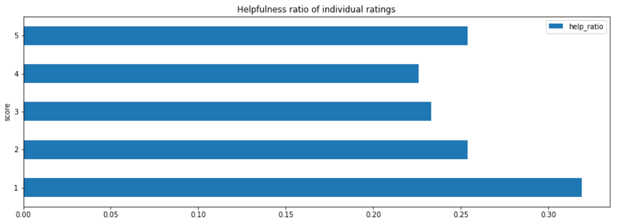
Helpfulness ratio
Percentage of people who found reviews helpful
Notes:
People tend to give more thumbs up for the extreme ends of reviews. Reviews written by extreme ends could be relatable with more people (write more serious reviews/more expressive) as they need to justify why they give such bad or good reviews.

Slide 9
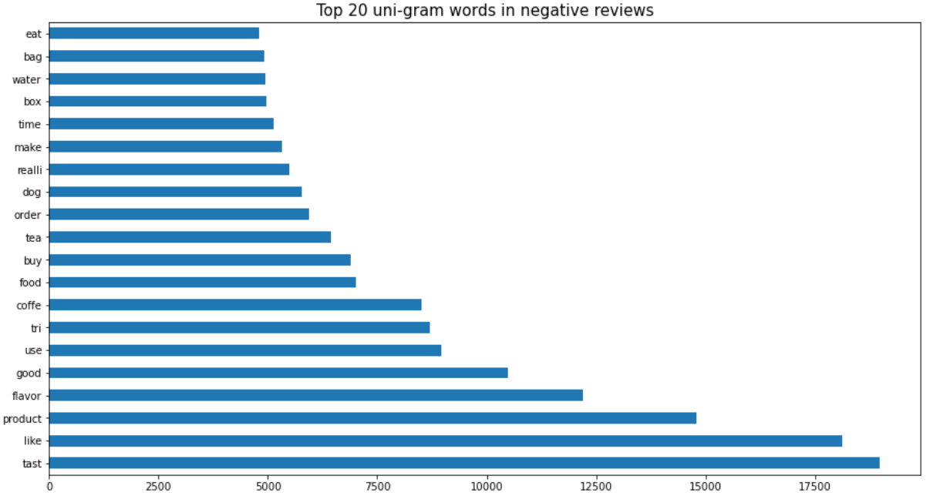
Top negative uni-gram words
“Too salty! This product is too salty for my taste. I strongly do not recommend it to those who like light flavor.I will not buy this product again…”

Slide 10
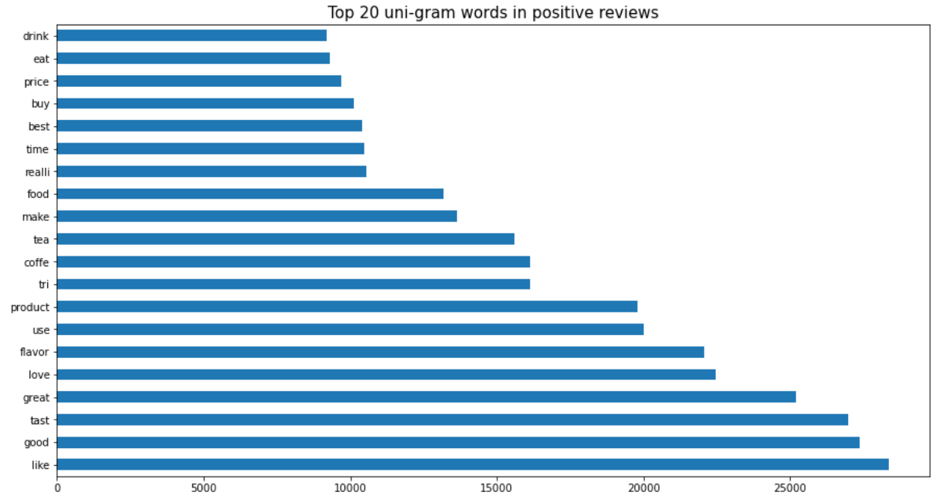
Top positive uni-gram words
“Best taste. Taste excellent with mix berries…”
"Happy customer...i only gave it four stars, b/c we don't love it, but we do like it…”

Slide 11
03
Modeling
Machine Learning & Deep Learning

Slide 12
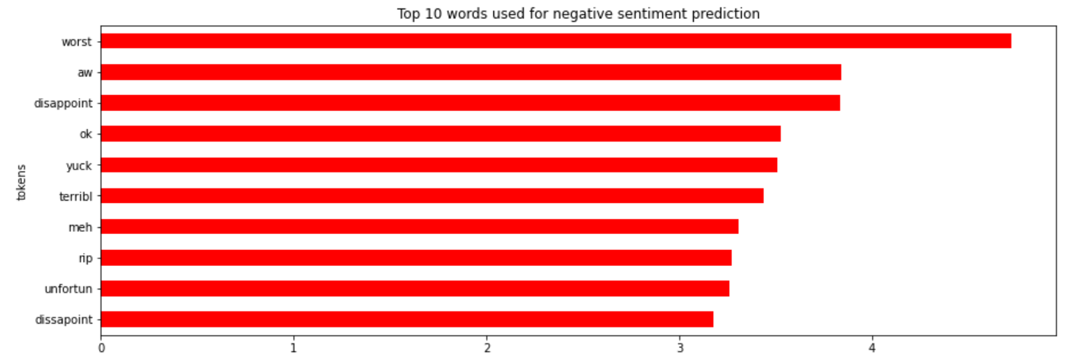
Machine Learning
Logistic Regression

Slide 13
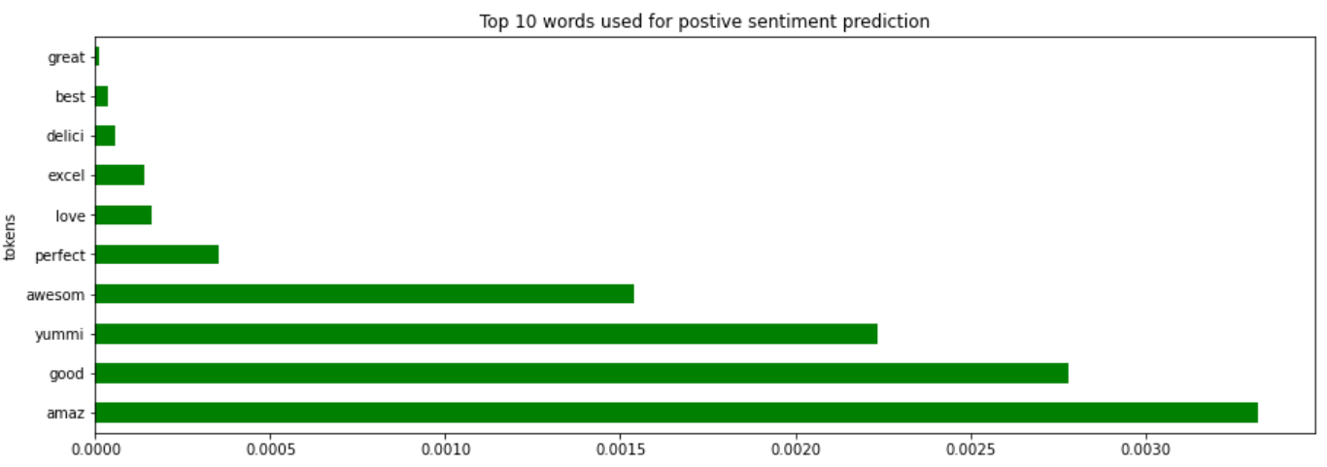
Machine Learning
Logistic Regression

Slide 14
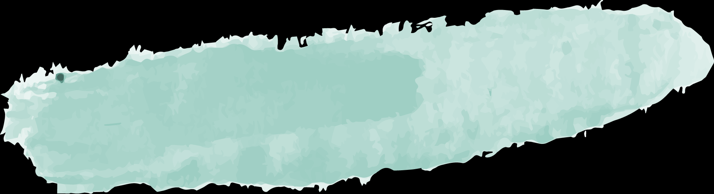

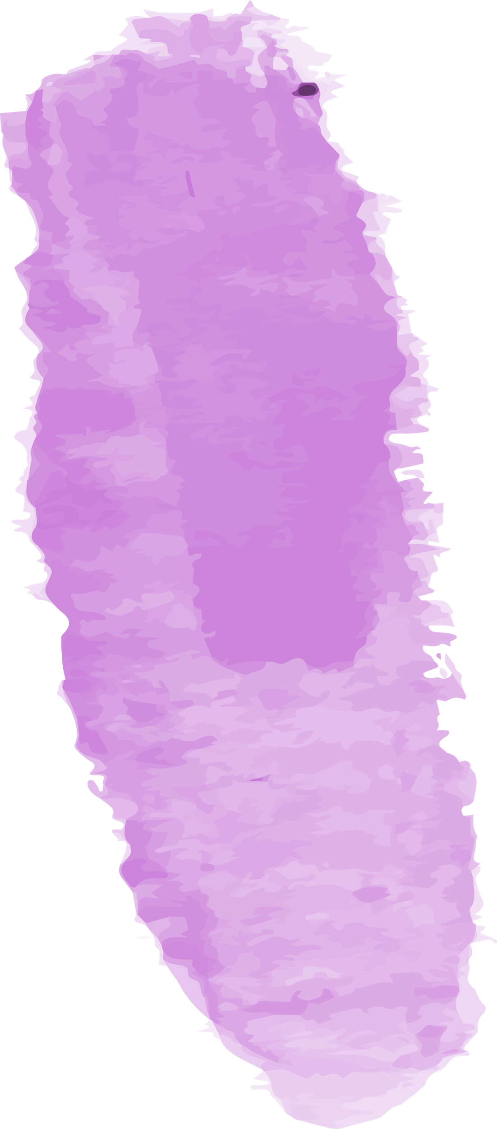

Deep Learning Network Topology
01
Sequential
Instantiate model
02
Embedding
Maps integer indices (specific words) to dense vectors (their embeddings)
03
Bidirectional LSTM
Past to future & future to past
04
Dense
Regular deeply connected neural network layer
Notes:
Sequential groups a linear stack of layers into a tf.keras.Model. Adds a layer instance on top of the layer stack.
A Sequential model is appropriate for a plain stack of layers where each layer has exactly one input tensor and one output tensor
Bidirectional LSTMs - Bidirectional RNNs will traverse the sequence in two Directions. Future to past and past to future, use context from right side to make predictions.
The idea of bidirectional RNN is to use two independent RNNs working together. The input is fed to one RNN in sequential order and in reverse order for other RNN
A Dense layer feeds all outputs from the previous layer to all its neurons, each neuron providing one output to the next layer. It's the most basic layer in neural networks

Slide 15

Word Embedding
Sequence
Pad
Tokenize and fit on text
[45, 32, 12]
[0, 0, 45, 32, 12]
Embedding
{‘this’ : 45, ‘is’ : 32, ‘great ’: 12}
[‘this’, ‘is’, ‘great’]
1 word
multiple dimension
Notes:
Create vocabulary, Form a sentence, Form maximum length.
Embedding is a vector for every word, direction of vector establish the sentiment of the word. By matching the words with the labels, it then can have a direction to start learning from

Slide 16
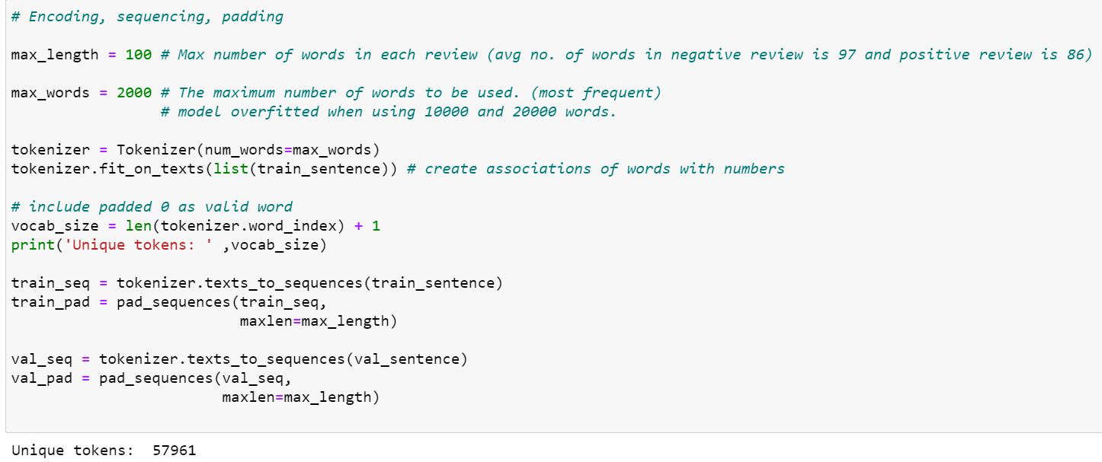
Pre-processing text
Notes:
the maximum number of words to keep, based on word frequency

Slide 17
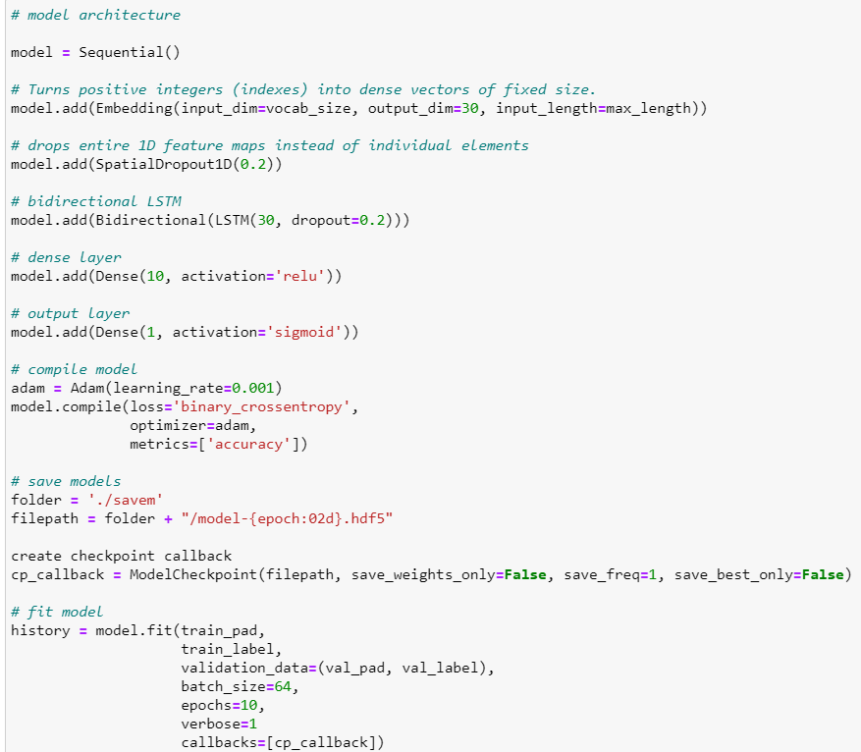
Hyperparameters
Notes:
(samples, sequence_length, embedding_dimensionality)
above defined values are the optimal hyperparameter values, but in some cases they may not be optimal.
It is always better idea to save Deep Learning models after they got trained, as they may take lot of time for training

Slide 18
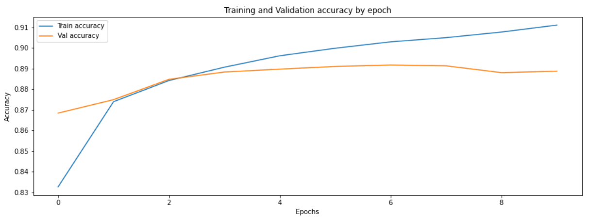
Training and Validation Accuracy

Slide 19
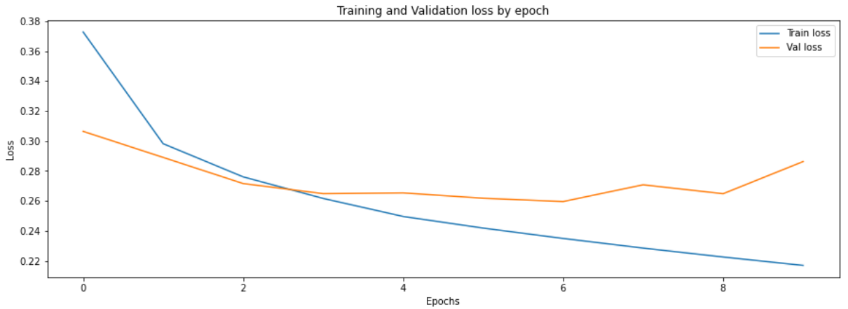
Training and Validation Loss

Slide 20
Misclassification
Predicted positive sentiment but actually negative (rating: 2)
Quality of product: positive
Unfortunately, I was hoping to get Jumbo Tiger Pops which are absolutely delicious. I have since found out that they may no longer be available in the USA. Jumbo TP come in four flavors--cherry, watermelon, grape, and orange--and are round. If anyone knows where they can be found, please post the answer. They are wonderful.
Notes:
Actually positive review because the person likes it but person written as negative because he wasn’t able to get the product
Main point is that product is no longer available.

Slide 21
Misclassification
Predicted negative sentiment but actually positive (rating: 4)
Dislike towards peach tea, but like Mango Peach
Our family has tried a number of different types of MIO, unfortunately the Peach tea is definitely not a favorite in our home. My daughter actually mixes it with the MIO Mango Peach, 1.62 Ounce (Pack of 4) and prefers that flavor.
Notes:
Comparing different flavours, preferring one to the other.

Slide 22
04
Evaluation

Slide 23
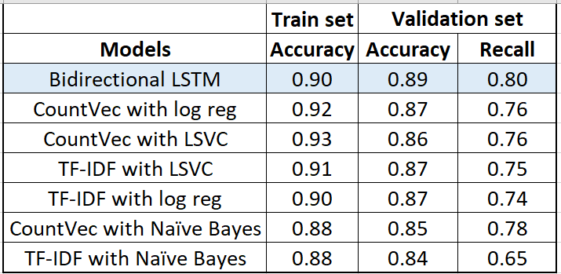
Scores
Baseline model:
VADER [Lexicon & rule-based sentiment analysis tool (social media)]
Accuracy score: 0.77 Recall score: 0.37
UNSEEN DATA (Minority class: 18%): Accuracy score: 0.92 Recall score: 0.79
Notes:
Not able to capture misspellings and grammatical errors that caused the analysis to overlook words.
Sarcasm may be misinterpreted as well.
There was some turns of phrase that weren't recognized.

Slide 24
Misclassification on unseen data
Predicted negative sentiment but actually positive (rating: 5)
Feedback on improvements too
Taste wise it is a 6 star item The mouth says, "How do I love thee, let me count the ways..."If you like apple products a must have item. The only draw back, shipping cost. These are very heavy.

Slide 25
Misclassification on unseen data
Predicted positive sentiment but actually negative (rating: 3)
Quality is good but price not good
How much would you pay for a bag of chocolate pretzels? If you're impulsive like me, then $6 is ok. Don't get me wrong, the quality of these babies is very good and I have no complaints. But in retrospect, the price is a little ridiculous (esp. when you add on the shipping).

Slide 26
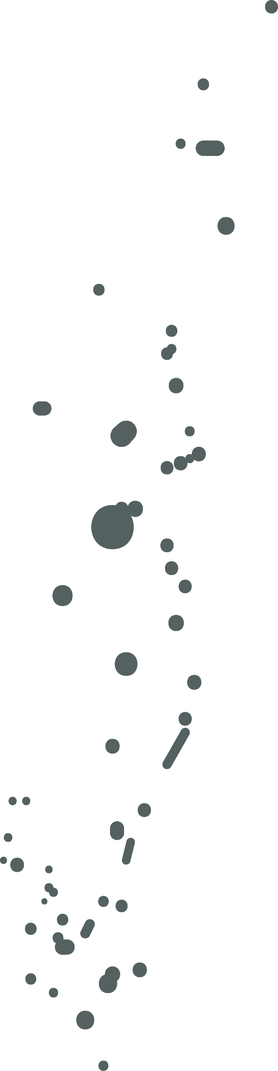
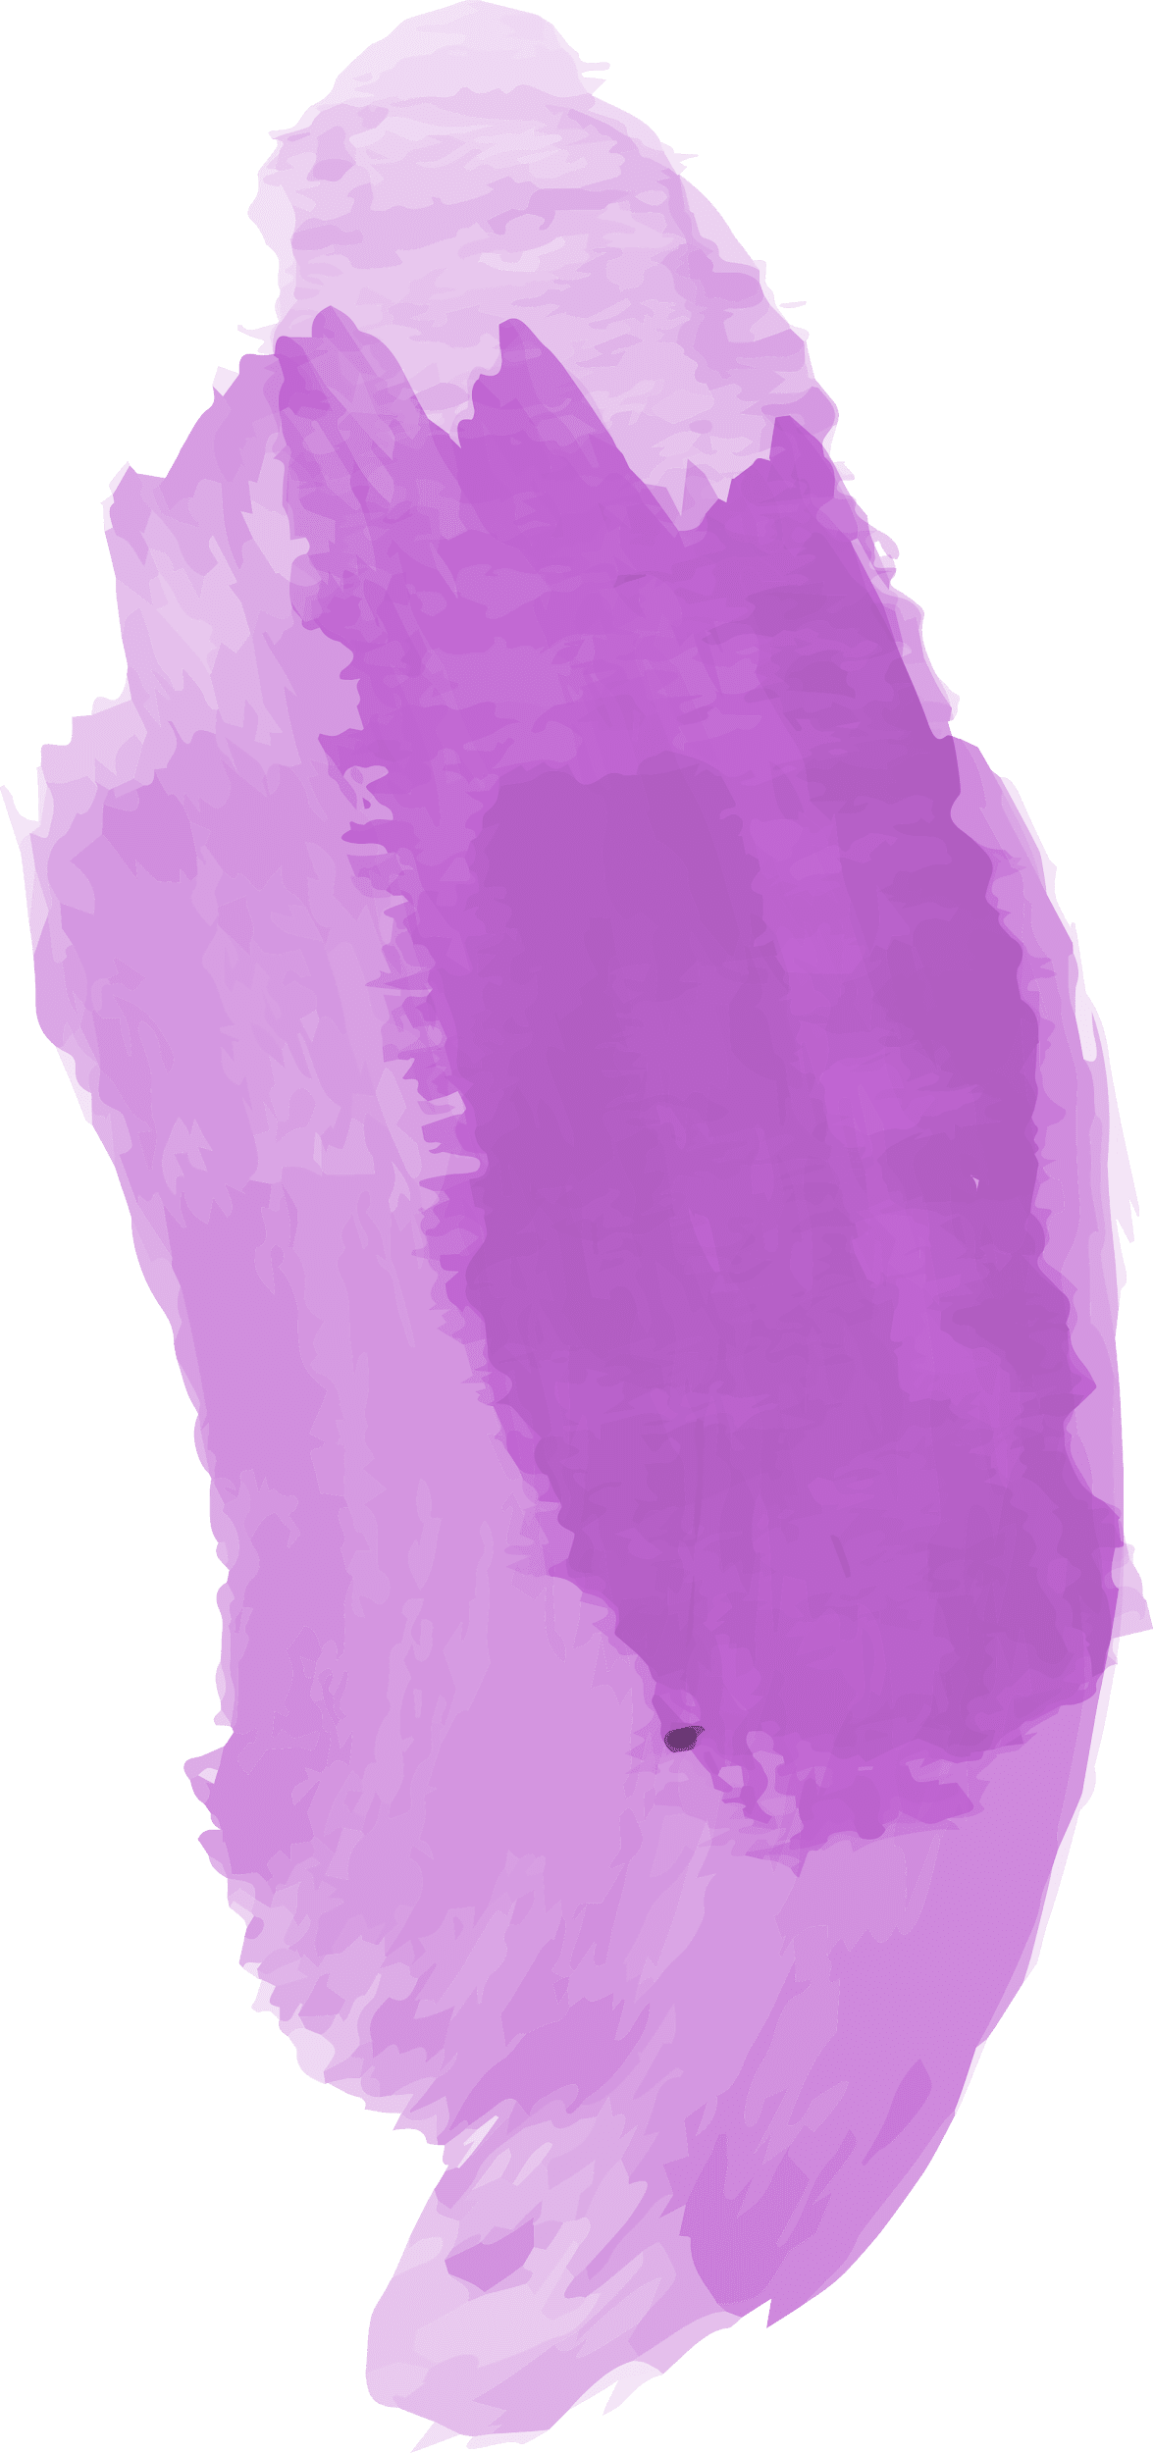



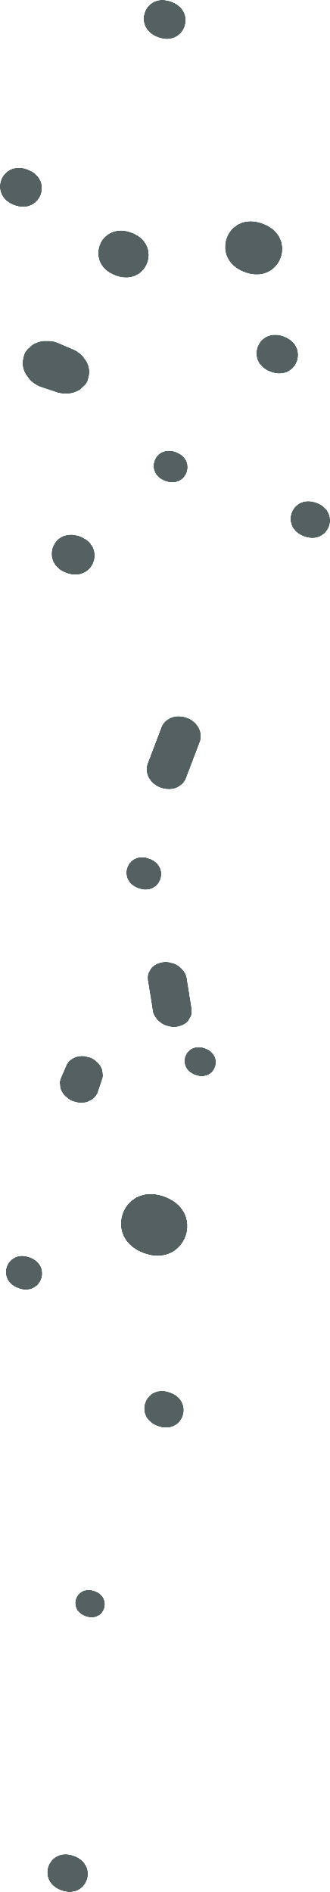




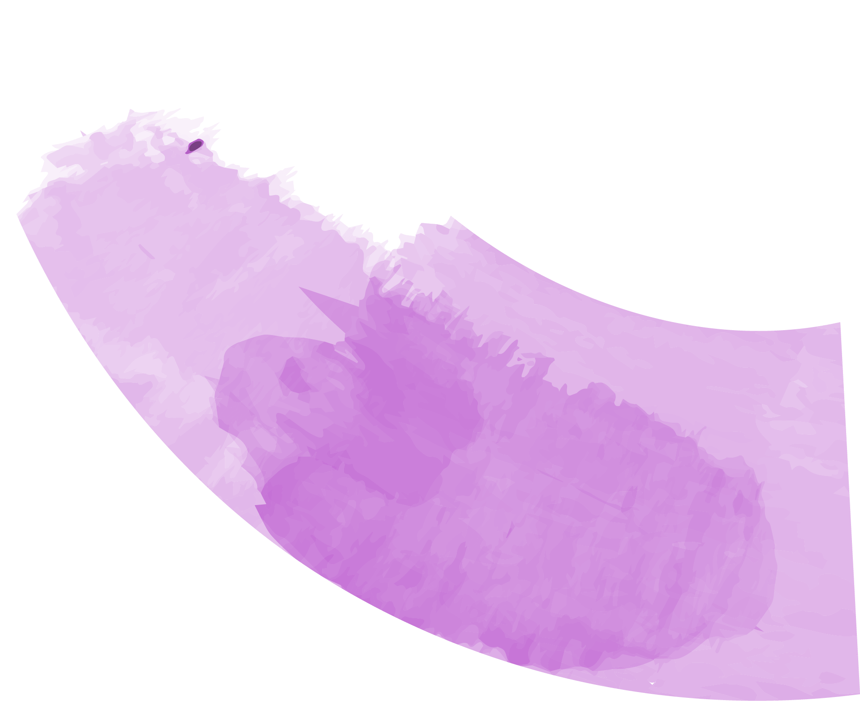


Negative Sentiment topics
Notes:
It is one of the most popular topic modeling methods
The LDA makes two key assumptions:
Documents are a mixture of topics
Topics are a mixture of tokens (or words)
As LDA assumes that documents are a mixture of topics and topics are a mixture of words so LDA backtracks from the document level to identify which topics would have generated these documents and which words would have generated those topics.

Slide 27
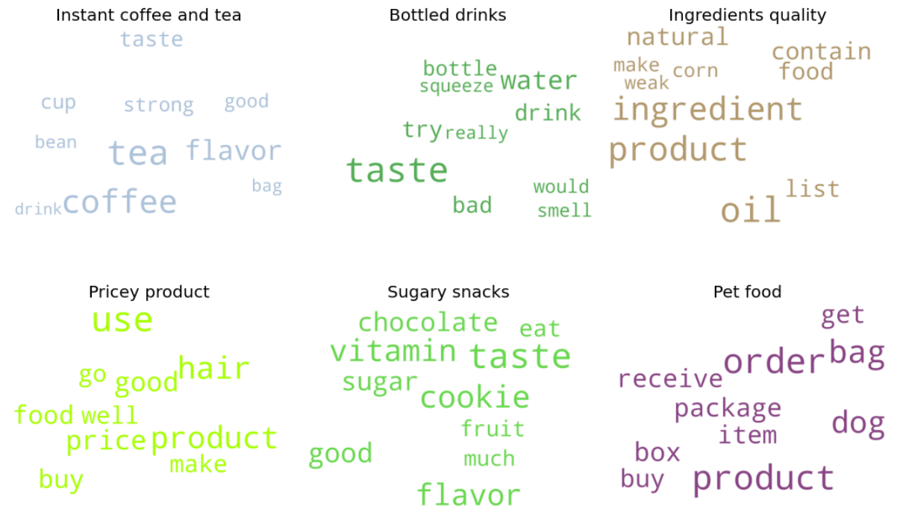
Notes:
Compute probabilities of
Proportion of words in document that currently assigned to topic
Proportion of documents in which the word is also assigned to topic
Using this probability, it estimate a new prob and identify new topic which is most relevant topic for current word

Slide 28
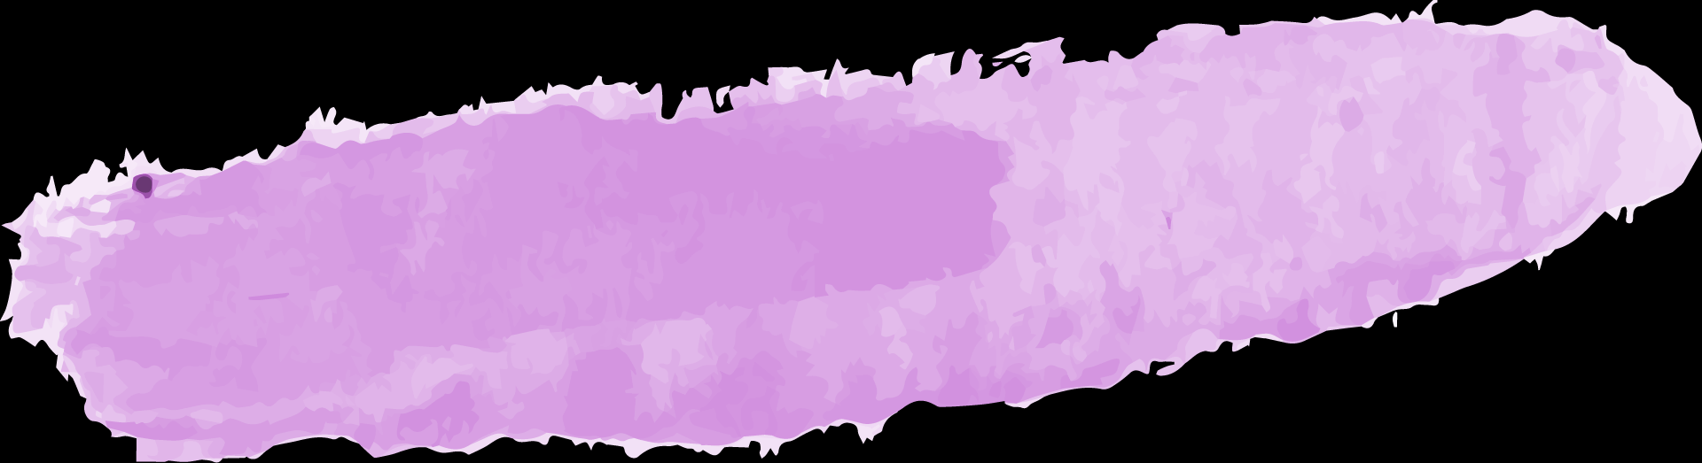

Recommendations and Conclusions
Manufacturers
R&D
Offer discounts
Improve products
Target qualities that customers are concerned about
To match low quality products
Follow up works
Follow up works
Further tuning of model
More in-depth analysis on topic modeling

Slide 29
THANKS
Do you have any questions?
addyouremail@freepik.com
+91 620 421 838
yourcompany.com
Please keep this slide for attribution

Slide 30


